Slide 1
Inoculation Against Misinformation
Results and Recommendations
Team: Reka Zempleni, Ben Ditchfield, Quentin Hsu, Ross Dahlke, Kushagra Gupta

Slide 2
Roadmap
1
2
3
Introduction
Results
Discussion
Motivation
Research Questions
Methodology
Identifying manipulative content
Identifying tactics
Sharing Behavior
HTE
Recommendations
Retrospective
Future Experiments

Slide 3
Roadmap
1
2
3
Introduction
Results
Discussion
Motivation
Research Questions
Methodology
Identifying manipulative content
Identifying tactics
Sharing Behavior
HTE
Recommendations
Retrospective
Future Experiments

Slide 4
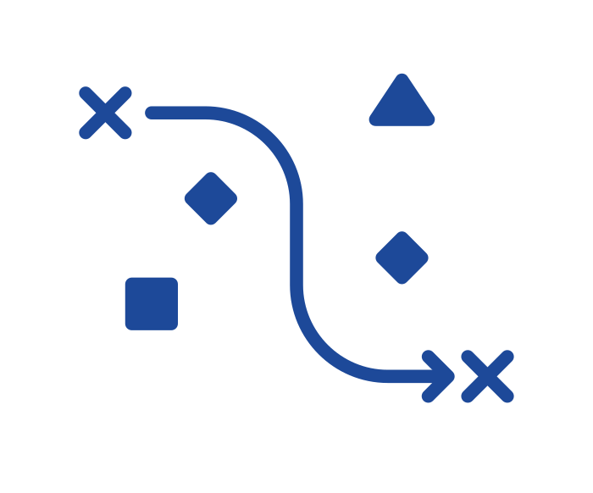
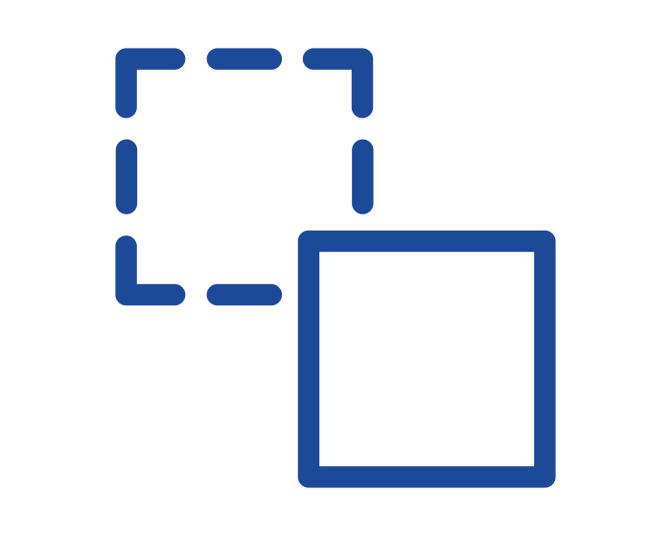

Motivation
1
Context
Online misinformation is a threat
Objectives
Identify low-cost intervention to reduce misinformation susceptibility, inc. identifying it & sharing it less frequently
Approach
Teaching manipulative tactics and analyzing how well respondents’ in different subgroups can subsequently identify each one
Notes:
Quick introduction to why this is important + big picture goals and very big picture of our approach. Disclaimer about misinformation versus manipulative information

Slide 5
Research Questions
1
Can a 6 minutes mini tactics course help users better identify manipulative content?
How effective is each of the three course elements?
Does the course help reduce sharing of manipulative content online and offline?
Are there heterogeneous treatment effects where our course works better for certain subgroups than others?
Based on baseline susceptibility, ideology, and income
I
II
III
IV
Notes:
based off of First Draft News’s “inoculation against misinformation” SMS course

Slide 6
Methodology
1
6-minute course on 3 tactics: misleading graphs (currently taught by First Draft), anecdotes (new), and false comparisons (new)
Survey Design
Demographic Questions
Pre-Test
Treatment Course
Post-Test
Attention check
Attention check
Control Course
64% (641) participants passed both attention checks
Pre-Post design reduces variability since we match participants to themselves; although it results in a longer survey and the pre and post questions need to be comparable
Notes:
Produce clean covariates for HTE analysis = Avoid influence on covariates by pre-test (or by entire thing)

Slide 7
Treatment and Control Courses
1
Treatment Excerpt Misinformation Course
Control Excerpt Sleep Course
When someone tells you about their experience with something, that story is called an anecdote, and they aren’t always reliable.
⁉️ How does that work?
⚠️ The danger of anecdotes is that they assume what’s true for one person should be true for everyone.
⏰ There are several strategies you can use to help manage a regular sleep schedule. One useful tip is to set an alarm clock. Alarms help us wake up in the morning, but we can use them to remind us to go to bed on time as well!
🚿 Another helpful strategy is setting a regular bedtime routine. This could involve taking a shower, tidying your bedroom, or reading a book.

Slide 8
Methodology
1
6-minute course on 3 tactics: misleading graphs (currently taught by First Draft), anecdotes (new), and false comparisons (new)
Survey Design
Demographic Questions
Pre-Test
Treatment Course
Post-Test
Attention check
Attention check
Control Course
64% (641) participants passed both attention checks
Pre-Post design reduces variability since we match participants to themselves; although it results in a longer survey and the pre and post questions need to be comparable
Notes:
Produce clean covariates for HTE analysis = Avoid influence on covariates by pre-test (or by entire thing)

Slide 9



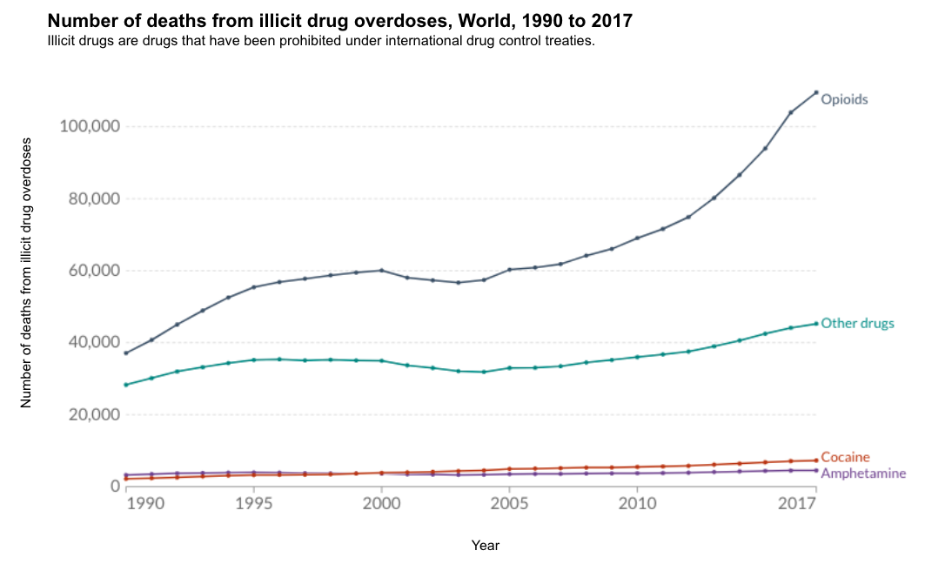
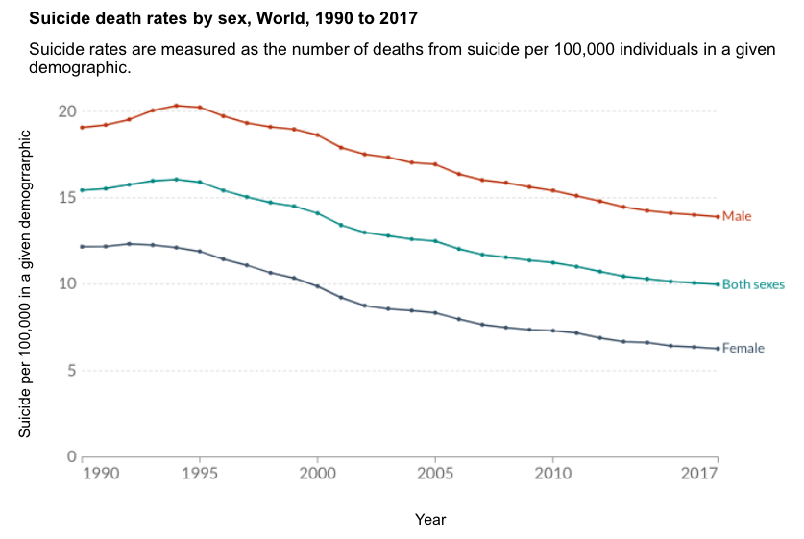
Pre- and Post- Questions
1
Example post
Tom
4 hrs
6 Posts in Random Order
Outcome Questions
True (no graph)
True (with graph)
Anecdote
Misleading graph
False comparison
Combined (with non-misleading graph)
How manipulative do you find this post? (6 point scale)
Which aspect of the post is manipulative? (multi-select)
Would you like to share this post on social media? (6 point scale)
Would you want to talk to others about this information offline? (6 point scale)
6 multi-select boxes
Post not manipulative
False comparison
Misleading anecdote
Manipulative graph
Evidence taken out of context
Other (require text entry)
We used 2 post of each type in the survey – one for the pre-test and one for the post-test
Global overdose deaths from opioids more than doubled from 1990 until 2017. This is an important issue that needs more attention.
Notes:
Which aspect of the post is manipulative? – mention that we had the tree covered tactics, one additional, none, other

Slide 10
Roadmap
1
2
3
Introduction
Results
Discussion
Motivation
Research Questions
Methodology
Identifying manipulative content
Identifying tactics
Sharing Behavior
HTE
Recommendations
Retrospective
Future Experiments

Slide 11
Key Findings
2
Manipulativeness - After our course, participants became more skeptical of all information: they labelled manipulative posts as 12 percentage points more manipulative, however, they also labelled non-manipulative courses 15 percentage points more manipulative
Tactics - Participants identify the tactics from the course more often across the board (regardless of whether they are present or not); overall skepticism may be driven by thinking about the tactics taught
Behaviors - Our tactics course did not seem to change online and offline sharing behavior
HTE - We found HTE for income only
I
II
III
IV
Notes:
These are our main findings to our research questions.

Slide 12
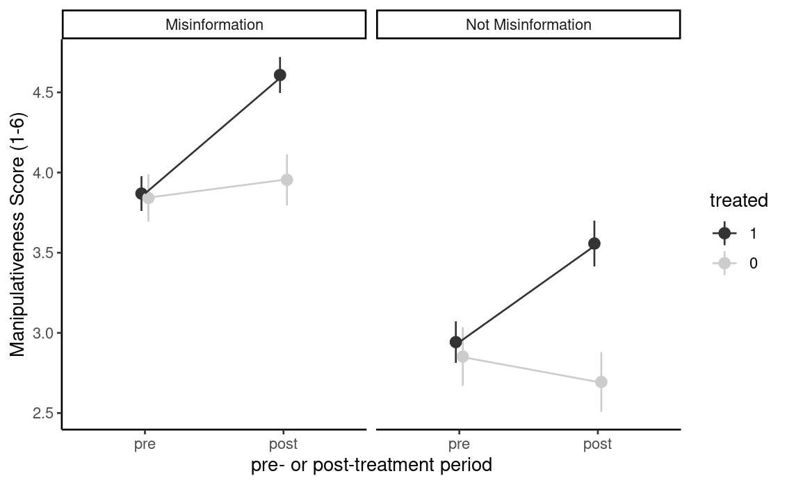
Participants became more skeptical overall
2.i
H1
SH1
Our true questions were tricky
May be a result of priming or the experimenter demand effect
Detrimental effect may not last as long as ability to identify misinfo, but this would have to be tested
+0.63
+0.77
Notes:
We see an increase in identifying manipulativeness, but also increase in true. Treatment seemed to make participants more skeptical - though we do not fully understand if this is good or bad in the long term.
Although we were successful in increasing identifying manipulative content, we wanted to better understand the consequences of this skepticism of our true content.

Slide 13
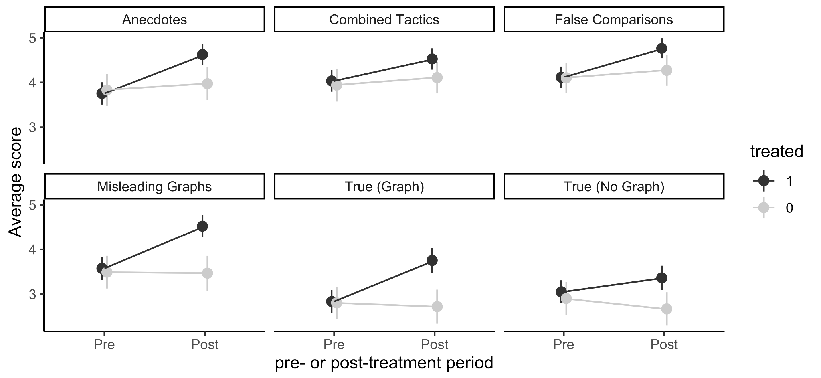
Participants became more skeptical overall
2.i
Misinformation Identification by Question Average Score on scale 1-6, with 6 being more misleading
Notes:
Treated participants rate all questions as more manipulative, so it wasn’t just a specific few questions (though the degree of change is different)

Slide 14
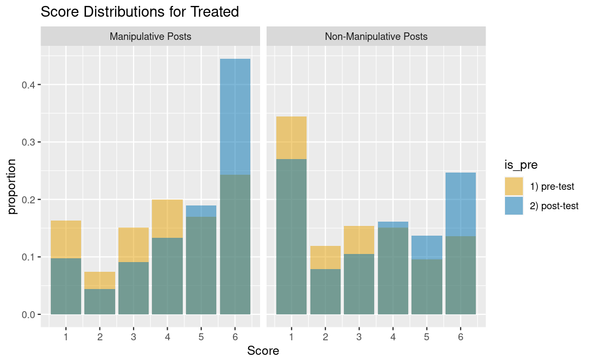
Change in perceived manipulativeness
2.i
Score Distribution for Treated
Notes:
Mention binary stuff, still no clear answer, let’s look at more possibilities
Much larger shift to 6 for manipulative posts. Seems like more confidence in identification.
More skepticism for true items, increase feels more distributed upwards, but not as confident as manipulative posts.

Slide 15
Controlling Variance
2.i
 |  | No Adjustment | Covariate Adjustment | Question Order Adjustment | All Adjustments
H1 | Treatment (est.) | 0.63 | 0.66 | 0.63 | 0.65
 | Std. Error | 0.09 | 0.14 | 0.09 | 0.14
 | Adj. p-value | 0 | 0 | 0 | 0
SH1 | Treatment (est.) | -0.77 | -0.77 | -0.78 | -0.78
 | Std. Error | 0.14 | 0.14 | 0.14 | 0.14
 | Adj. p-value | 0 | 0 | 0 | 0
Notes:
SH1

Slide 16
Key Findings
2
Manipulativeness - After our course, participants became more skeptical of all information: they labelled manipulative posts as 12 percentage points more manipulative, however, they also labelled non-manipulative courses 15 percentage points more manipulative
Tactics - Participants identify the tactics from the course more often across the board (regardless of whether they are present or not); overall skepticism may be driven by thinking about the tactics taught
Behaviors - Our tactics course did not seem to change online and offline sharing behavior
HTE - We found HTE for income only
I
II
III
IV
Notes:
Main task of increased identification of manipulativeness along with some unfortunate side effects, let’s now understand the driver of the increase in manipulativeness and whether they learned the tactics that we taught them.

Slide 17

Tactics Metrics
2.ii
Metric Definitions
 |  | Posts
 |  | True Post | Anecdote Post
 | True
 | Anecdote
Participant Response
Notes:
Clearly define accuracy
Drop in accuracy across the board. Accuracy is based off of ,
## Tactics

Slide 18
Tactics Metrics
2.ii
Metric Definitions
Accuracy
For every checkbox, did the participant correctly check or uncheck the checkbox?
 |  | Posts
 |  | True Post | Anecdote Post
 | True
 | Anecdote
+
Participant Response
Notes:
Clearly define accuracy
Drop in accuracy across the board. Accuracy is based off of ,
## Tactics

Slide 19
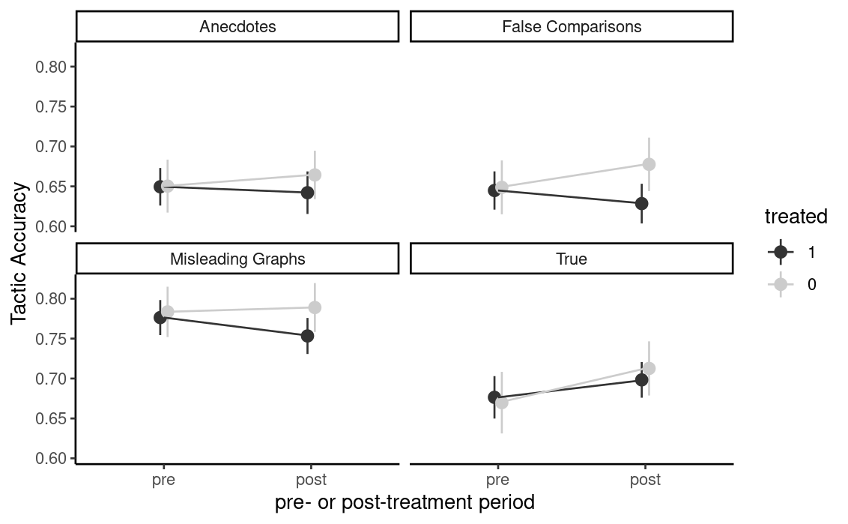

Drop in accuracy in identifying specific tactics
2.ii
Tactic Accuracy
Not stat sig!
Notes:
Clearly define accuracy
Drop in accuracy across the board. Accuracy is based off of ,
## Tactics

Slide 20
Tactics Metrics
2.ii
Metric Definitions
True Positive Rate (Recall)
When the tactic was present in the post, did the participant identify the tactic?
 |  | Posts
 |  | True Post | Anecdote Post
 | True
 | Anecdote
Participant Response
Notes:
Clearly define accuracy
Drop in accuracy across the board. Accuracy is based off of ,
## Tactics

Slide 21
Tactics Metrics
2.ii
Metric Definitions
False Positive Rate
When the tactic was NOT present in the post, did the participant mistakenly choose the tactic?
 |  | Posts
 |  | True Post | Anecdote Post
 | True
 | Anecdote
Participant Response
Notes:
Clearly define accuracy
Drop in accuracy across the board. Accuracy is based off of ,
## Tactics

Slide 22
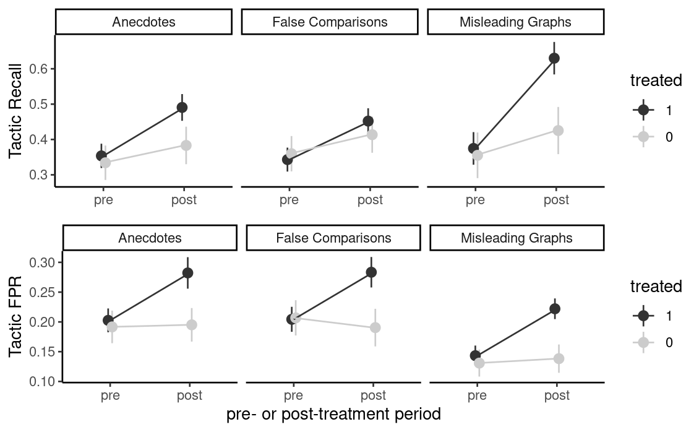
Better at noticing tactics, but more false positives!
2.ii
Tactic True Positive Rate (Recall)
Tactic False Positive Rate
Notes:
Improvement in catching when the tactic exists. More false positives as well.
Investigate the increase in FPR

Slide 23
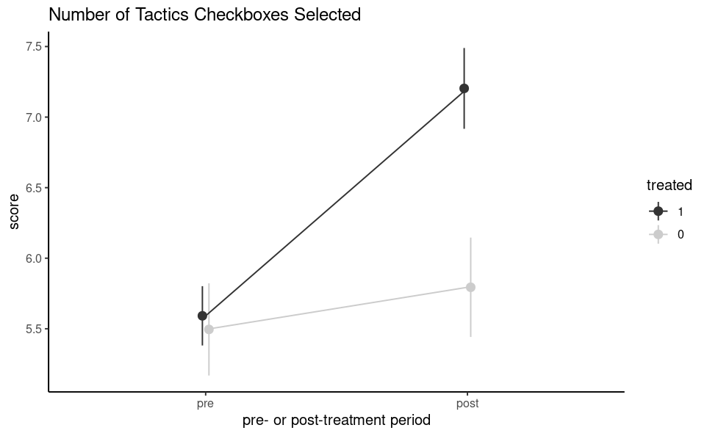
Participants selected tactics more often
2.ii
Number of Tactics Checkboxes Selected
Notes:
Selecting more checkboxes (multiselect)

Slide 24
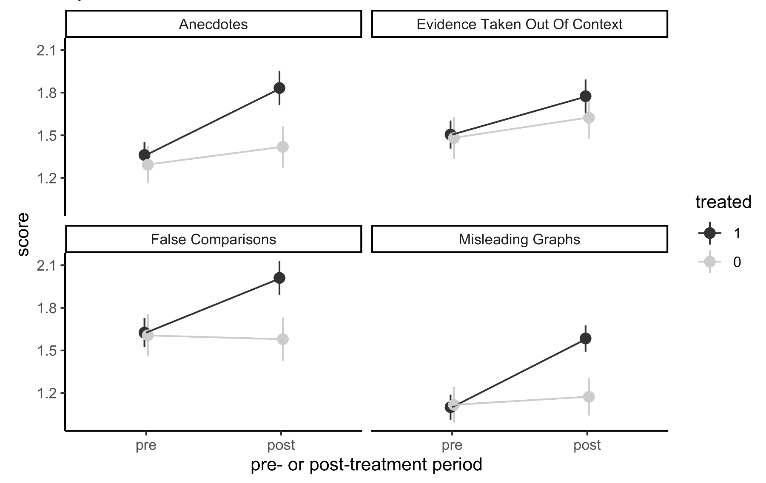
But only for the tactics that we taught them!
2.ii
Number of Tactics Selected by Participants

Slide 25

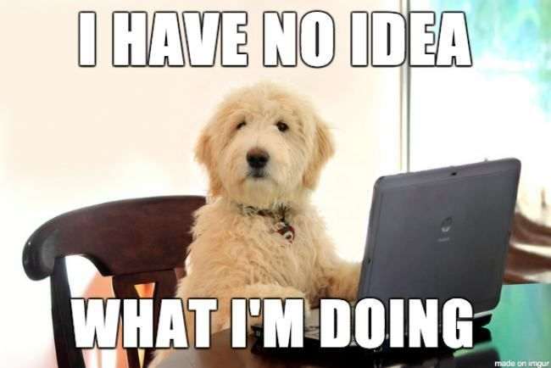
So did they learn anything?
2.ii
I’ll select a few more checkboxes just in case!

Slide 26
Tactics Metrics
2.ii
Metric Definitions
Precision
When a participant selects a tactic, is it present in the post?
 |  | Posts
 |  | True Post | Anecdote Post
 | True
 | Anecdote
Participant Response
Notes:
Clearly define accuracy
Drop in accuracy across the board. Accuracy is based off of ,
## Tactics

Slide 27
So did they learn anything?
2.ii
I’ll select a few more checkboxes just in case!
Precision should go down
Precision should remain same or go up

Slide 28
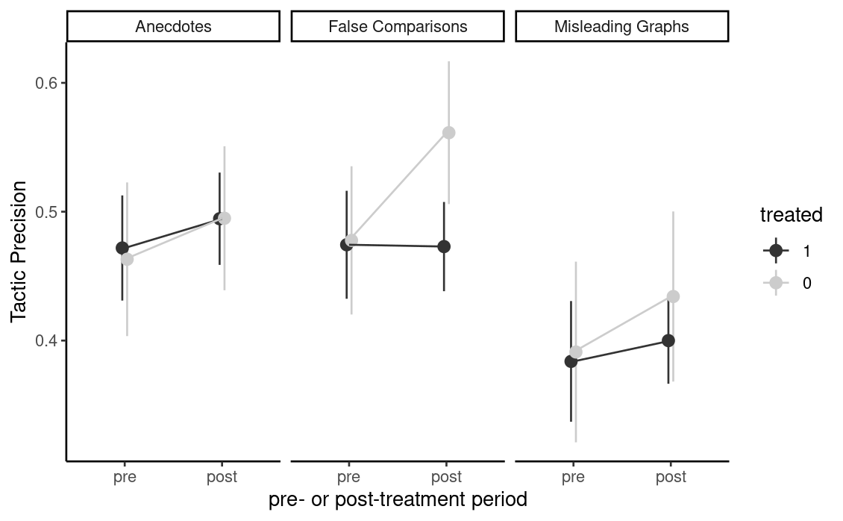
Precision did not decrease, so not randomly selecting tactics
2.ii
Tactic Precision
Notes:
Improvement in catching when the tactic exists. More false positives in recognition of tactic

Slide 29
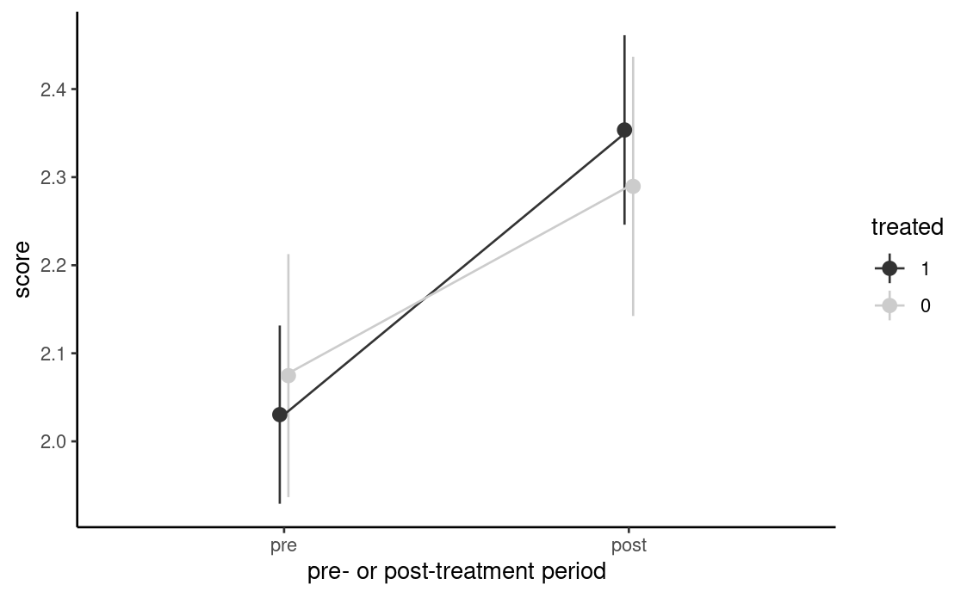
What if we did not penalize false positives?
2.ii
Tactics Identification (Binary without FP Penalty)
Participants scored 1 if:
The post was true, and they recognized it wasn’t misleading
The post was misleading, and they selected the correct tactic (not penalized if they select additional tactics)
Participants scored 0 otherwise
Notes:
Improvement in catching when the tactic exists. More false positives in recognition of tactic

Slide 30
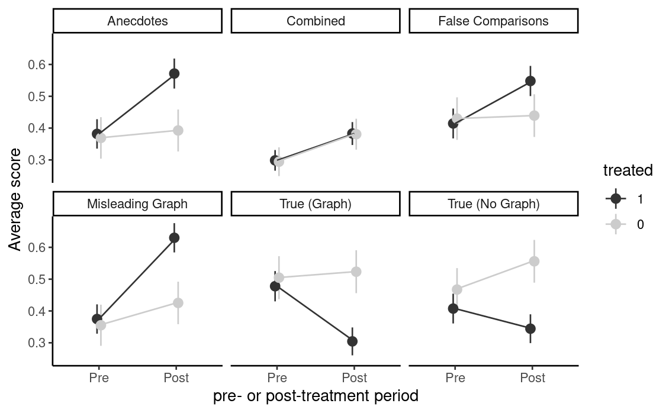
What if we did not penalize false positives?
2.ii
Tactics Identification (Binary without FP Penalty)
Notes:
Minimal change mainly due to opposing directions of true again

Slide 31
Tactics: Summary
2.ii
Participants could better identify tactics present in a post But became more likely to select other (incorrect) tactics as well
Participants became more likely to select >1 tactic per post But they didn’t seem to be randomly selecting tactics
Treatment caused participants to be skeptical of true posts But measuring their performance generously suggests a positive effect overall
Notes:
(potentially to be safe with their choices).

Slide 32
Controlling Variance – Tactics statistic (1/2)
2.ii
 |  | No Adjustment | Covariate Adjustment | Question Order Adjustment | All Adjustments
Misleading Graph Accuracy | Treatment (est.) | -0.03 | -0.03 | -0.03 | -0.03
 | Std. Error | 0.02 | 0.02 | 0.02 | 0.02
 | Adj. p-value | 0.08 | 0.08 | 0.09 | 0.09
Anecdotes Accuracy | Treatment (est.) | -0.02 | -0.02 | -0.02 | -0.02
 | Std. Error | 0.02 | 0.02 | 0.02 | 0.02
 | Adj. p-value | 0.25 | 0.31 | 0.26 | 0.34
Notes:
Accuracy + slide 20

Slide 33
Controlling Variance – Tactics statistic (2/2)
2.ii
 |  | No Adjustment | Covariate Adjustment | Question Order Adjustment | All Adjustments
False Comparison Accuracy | Treatment (est.) | -0.04 | -0.04 | -0.04 | -0.04
 | Std. Error | 0.02 | 0.02 | 0.02 | 0.02
 | Adj. p-value | 0.02 | 0.01 | 0.02 | 0.02
Binary without FP penalty | Treatment (est.) | 0.13 | 0.13 | 0.14 | 0.14
 | Std. Error | 0.13 | 0.13 | 0.13 | 0.13
 | Adj. p-value | 0.31 | 0.31 | 0.28 | 0.28
Notes:
Accuracy + slide 20
More in appendix

Slide 34
Key Findings
2
Manipulativeness - After our course, participants became more skeptical of all information: they labelled manipulative posts as 12 percentage points more manipulative, however, they also labelled non-manipulative courses 15 percentage points more manipulative
Tactics - Participants identify the tactics from the course more often across the board (regardless of whether they are present or not); overall skepticism may be driven by thinking about the tactics taught
Behaviors - Our tactics course did not seem to change online and offline sharing behavior
HTE - We found HTE for income only
I
II
III
IV

Slide 35
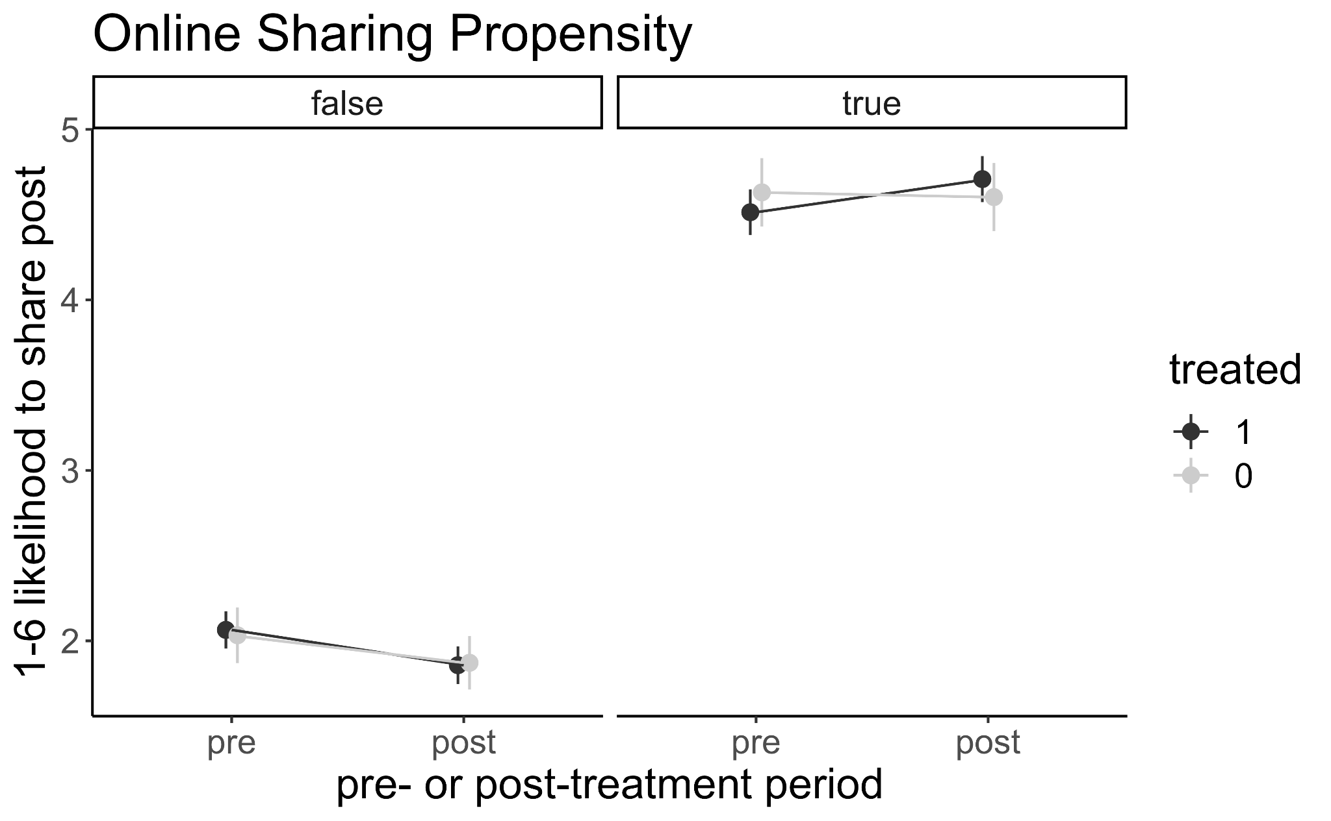
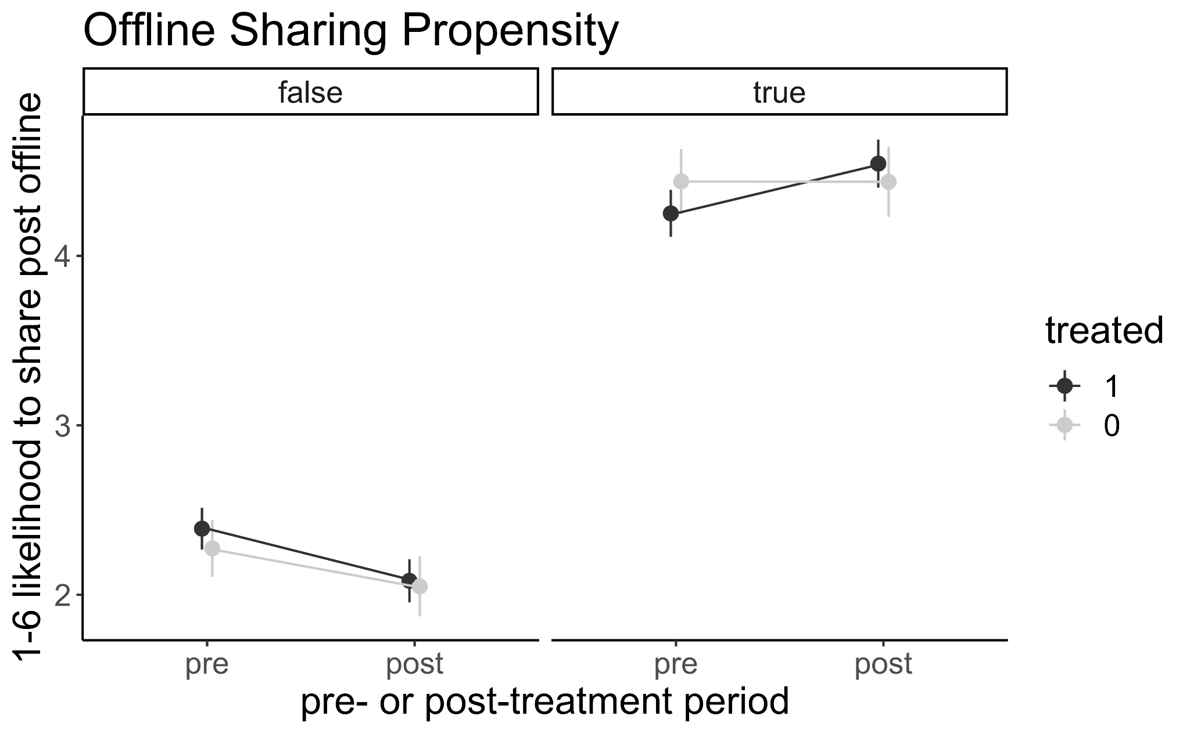
Our course did not change sharing behavior
2.iii
Online Behavior
Offline Behavior
This result is not unexpected since the course does not steer users towards sharing less. We also do not ask users’ their sharing intention (e.g. if they’re sharing content to debunk it).

Slide 36
Key Findings
2
Manipulativeness - After our course, participants became more skeptical of all information: they labelled manipulative posts as 12 percentage points more manipulative, however, they also labelled non-manipulative courses 15 percentage points more manipulative
Tactics - Participants identify the tactics from the course more often across the board (regardless of whether they are present or not); overall skepticism may be driven by thinking about the tactics taught
Behaviors - Our tactics course did not seem to change online and offline sharing behavior
HTE - We found HTE for income only
I
II
III
IV

Slide 37
HTE Results on identifying misinformation
2.iv
 | Misinformation Susceptibility | Political Ideology | Income
Treatment (est.) | 0.01 | -0.04 | -0.04
Std. Error | 0.02 | 0.08 | 0.02
Adj. p-value | 0.58 | 0.60 | 0.02
Notes:
SH1

Slide 38
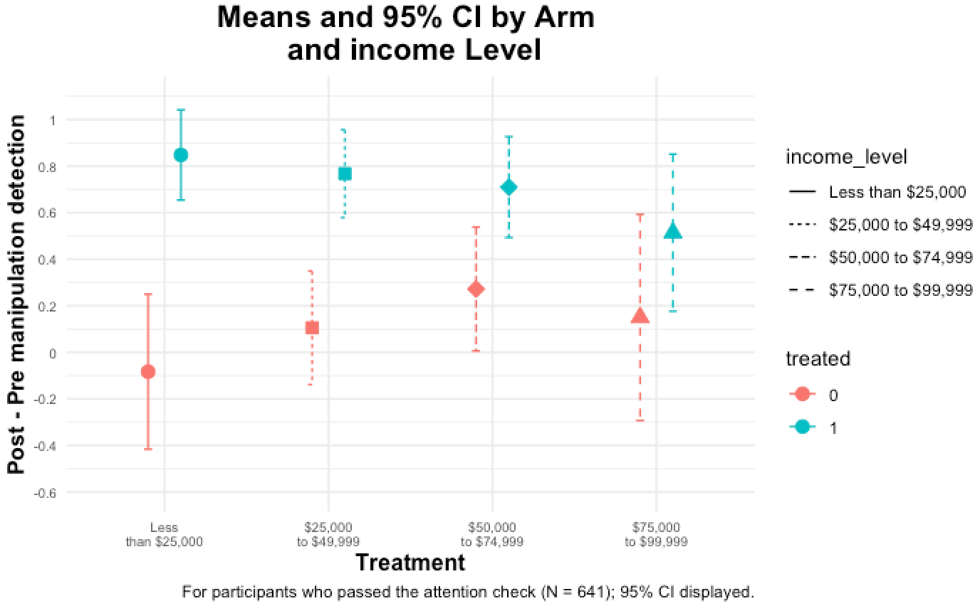
HTE: Income
2.iv

Slide 39
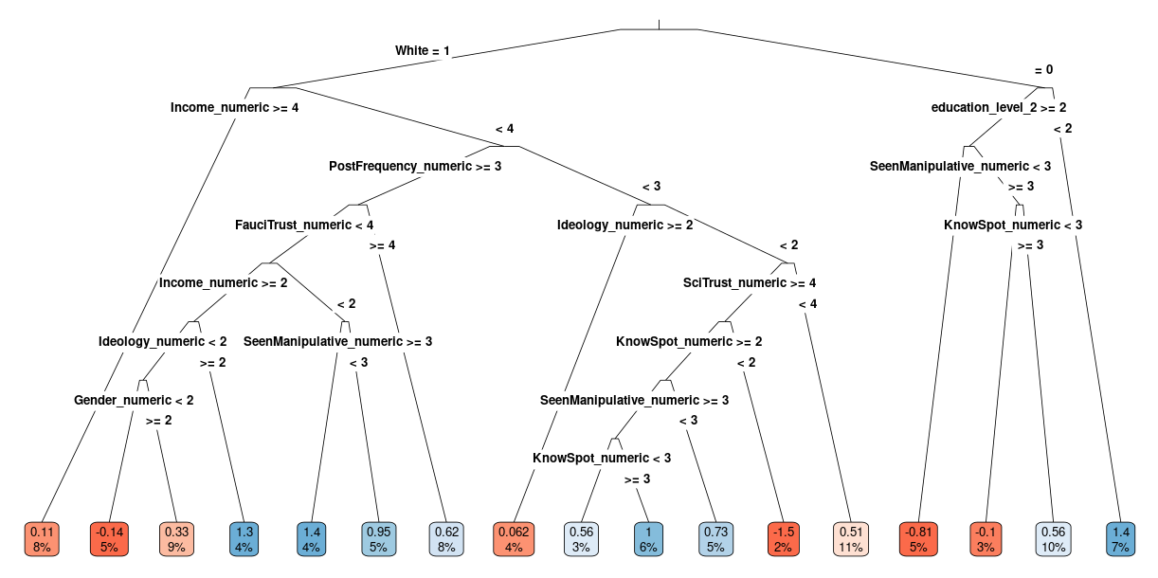
HTE: Our results were consistent across groups
2.iv
Causal Trees Analysis

Slide 40
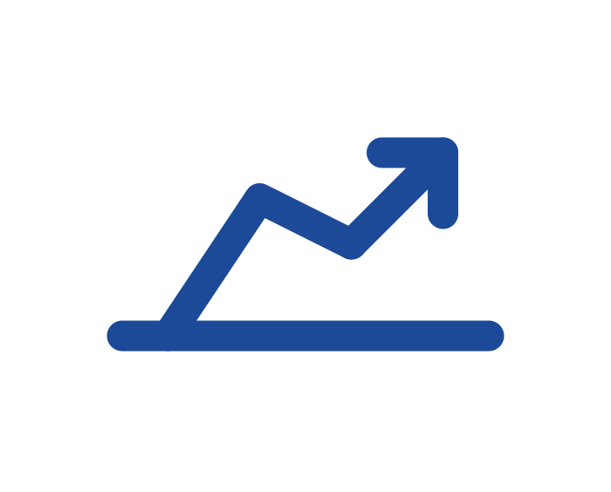


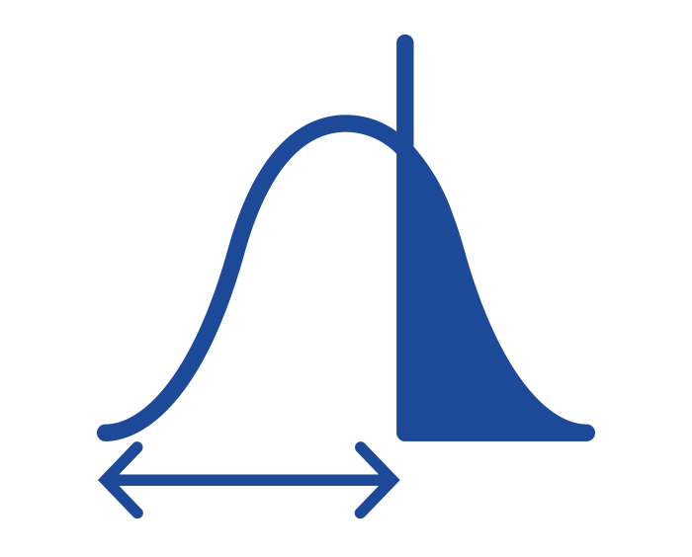

Our results are robust to adjustments
2
Additional Analyses Included In Our Report
Control for question order randomization
Covariate Adjustment
Non-linear binary cut for main outcome
Covariate Balance
Multiple hypo. correction via bootstrap
None of these analyses changed our substantive results

Slide 41
Roadmap
1
2
3
Introduction
Results
Discussion
Motivation
Research Questions
Methodology
Identifying manipulative content
Identifying tactics
Sharing Behavior
HTE
Recommendations
Retrospective
Future Experiments

Slide 42
Findings & Recommendations for First Draft
3
Findings
Recommendations
Even a 6 minutes mini course made participants alert
Continue teaching tactics
The new tactics (anecdotes and false comparisons) perform comparably to graphs
Consider including these new tactics, as well as others from FLICC
2 minutes per tactic may be too short
Consider more touchpoints for each tactic
Only teaching tactics is insufficient to change sharing behavior
Consider focusing specifically on desired behavioral changes
Delivery method seemed effective (interactive, non-polarised content)
Use these elements in delivery
Consider additional research to confirm/expand our findings – see next slides
Notes:
Higher touch might be needed, tactics are promising, explore additional ones, address general skepticism with follow up, rave reviews - general design is good, generaliyability

Slide 43
Limitations & What Could Have Been Different
3
Trend | We didn’t… | We could have included…
Participants became more skeptical of all information (although we don’t know exactly why) | Measure how participants interpreted the 6-point scale | An arm with a binary outcome to compare with other participants
 | Emphasize that false positives are not desirable | Incentives to only identifying those tactics actually present
 | Capture confidence in tactic selection | Measures of confidence
 | Calibrate our test questions which may have been too difficult (e.g. true questions contained non-misleading anecdotes) | More straightforward prompts
Some outcomes had high variance and/or small effects | Explicitly discuss sharing in the course | A more targeted treatment
 | Ask participants their motivation for sharing | Questions asking participants about their motivation to share

Slide 44




Future Research
3
Larger Sample Size
Reduce variance and increase power
Increased Intervention Time
Deliver intervention with greater intensity
Could focus on other areas of interest like behaviors (e.g. drawbacks of sharing content with misinformation)
Longer Horizon for Outcome Measurement
Offer participants an opportunity for fact-checking
Measure long-term outcomes to reduce priming
Link to social media accounts to measure actual impact
Improve Participant Incentives
Could pay a reward of a few cents for correctly identifying tactics
May reduce priming and experiment demand effect

Slide 45
Appendix

Slide 46
Project Context + Motivations
Misinformation requires context & related behavior
Limited by 15 minutes survey + course
Manipulative tactics commonly used to deliver misinformation
Goal: Teach participants several common tactics so that they can recognize these posts as manipulative.
Partner interest in less studied ones

Slide 47
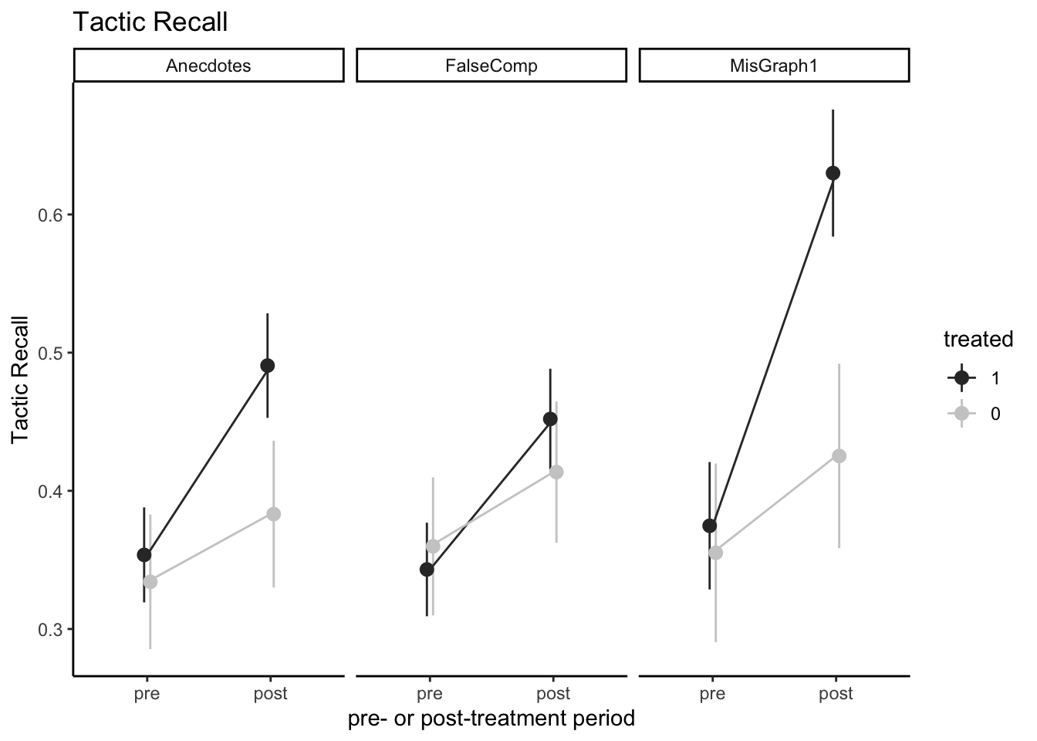
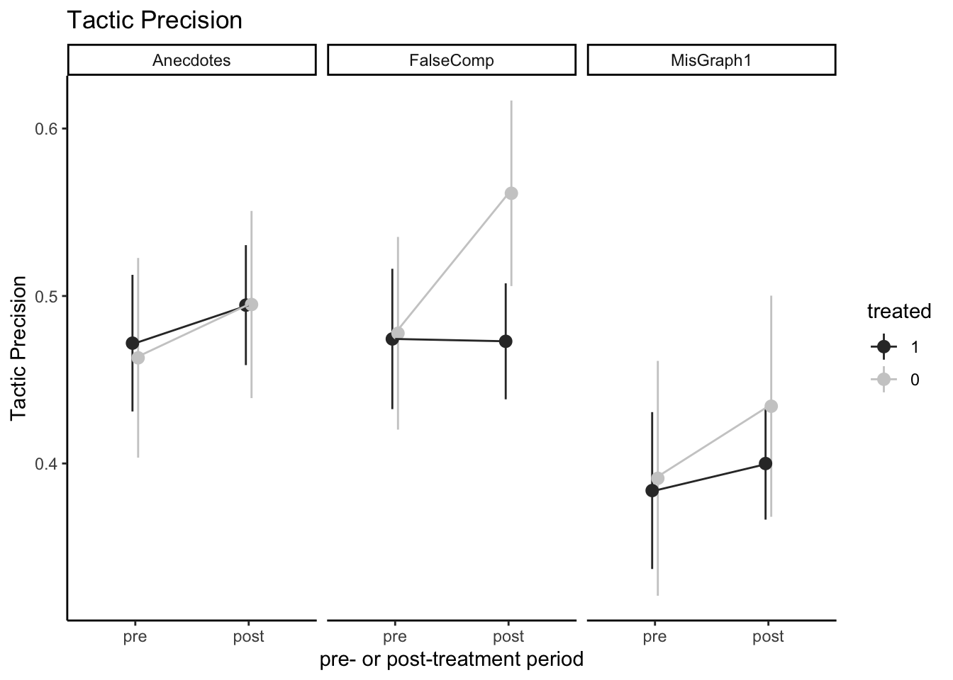
Better at noticing tactics, but more false positives
2.ii
Notes:
Improvement in catching when the tactic exists. More false positives in recognition of tactic

Slide 48
Better at noticing tactics, but more false positives!!!
2.ii
Precision | Misleading graph | Anecdotes | False comparison
Pre-test baseline | 0.39 | 0.47 | 0.48
estimate | -0.06 | -0.01 | -0.08
conf.low | -0.24 | -0.16 | -0.22
conf.high | 0.12 | 0.14 | 0.07
Adjusted p-value | 0.36 | 0.87 | 0.12
Recall | Misleading graph | Anecdotes | False comparison
Pre-test baseline | 0.37 | 0.35 | 0.35
estimate | 0.19 | 0.09 | 0.06
conf.low | 0.03 | -0.02 | -0.05
conf.high | 0.34 | 0.19 | 0.16
Adjusted p-value | 0.00 | 0.02 | 0.13
Notes:
Improvement in catching when the tactic exists. More false positives in recognition of tactic

Slide 49
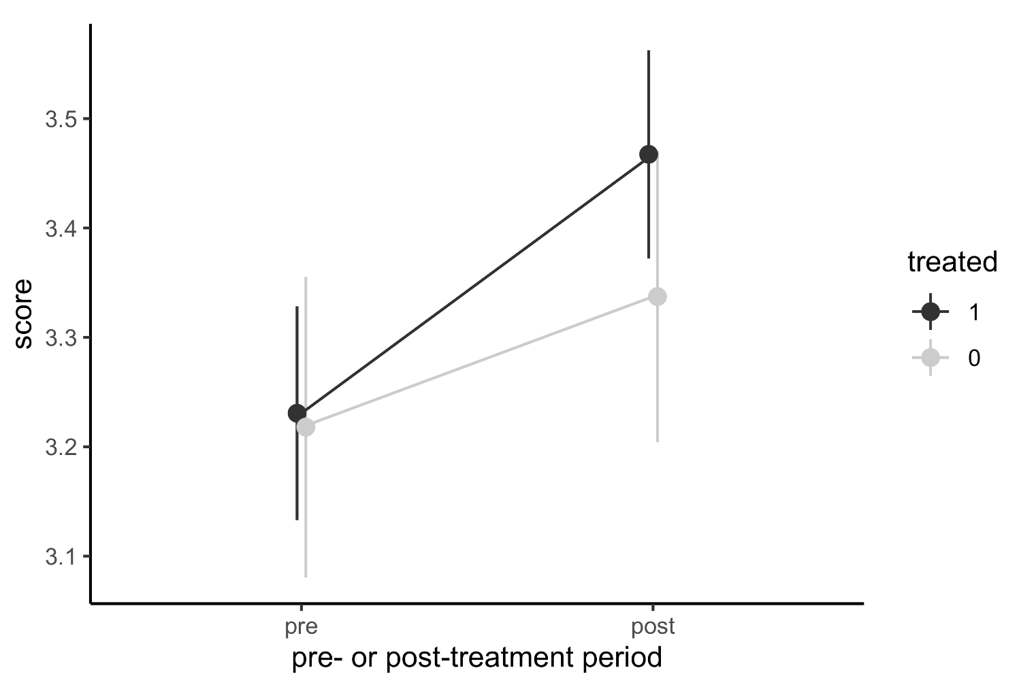
What if we penalize even less?
2.ii
Tactics Identification (“OR Statistic”)
Participants scored 1 if:
The post was true, and they recognized it wasn’t misleading
The post was misleading, and they selected one of the tactics covered by the course
Participants scored 0 otherwise
Notes:
Improvement in catching when the tactic exists. More false positives in recognition of tactic

Slide 50
Controlling Variance - H5, H6
H5 online |  | No Adjustment | Covariate Adjustment | Question Order adjustment | All Adjustment
 | Treatment (estimate) | -0.05 | -0.21 | -0.05 | -0.21
 | Std Error | 0.07 | 0.09 | 0.07 | 0.09
 | Adjusted p-value | 0.52 | 0.02 | 0.49 | 0.03
H6 offline | Treatment (estimate) | -0.08 | -0.26 | -0.78 | -0.26
 | Std Error | 0.08 | 0.09 | 0.08 | 0.09
 | Adjusted p-value | 0.29 | 0 | 0.28 | 0

Slide 51
Controlling Variance - Individual Tactics statistic
True - Binary without FP Penalty |  | No Adjustment | Covariate Adjustment | Question Order adjustment | All Adjustment
 | Treatment (estimate) | -0.19 | -0.19 | -0.19 | -0.19
 | Std Error | 0.05 | 0.05 | 0.05 | 0.05
 | Adjusted p-value | 0 | 0 | 0 | 0
Misleading Graph - Binary without FP Penalty | Treatment (estimate) | 0.18 | 0.18 | 0.19 | 0.19
 | Std Error | 0.05 | 0.05 | 0.05 | 0.05
 | Adjusted p-value | 0 | 0 | 0 | 0

Slide 52
Controlling Variance - Individual Tactics statistic
Anecdotes - Binary without FP Penalty |  | No Adjustment | Covariate Adjustment | Question Order adjustment | All Adjustment
 | Treatment (estimate) | 0.17 | 0.17 | 0.17 | 0.17
 | Std Error | 0.05 | 0.05 | 0.05 | 0.05
 | Adjusted p-value | 0 | 0 | 0 | 0
False Comparison - Binary without FP Penalty | Treatment (estimate) | 0.12 | 0.12 | 0.12 | 0.12
 | Std Error | 0.05 | 0.05 | 0.05 | 0.05
 | Adjusted p-value | 0.02 | 0.02 | 0.02 | 0.01

Slide 53
Narrative of results
More skeptical about misinfo
Also more skeptical about individual tactics (identification)
Depending on how we measure / how we care about the outcome, there is an improvement/decline/no change
It comes down to people selecting the tactics more, the ones that were taught
→ some effect of the course
For the real world we care whether people find tactics in manipulative ones and only those
Show new binary graph, → suggestive evidence of improvement, need more power
Sharing behavior
Only indirectly targeted (implicit assumption: if people are better at identifying misinfo, they should be sharing less misinfo. If already the first part only has small effects, should be even smaller for overall sharing behavior)
Would need more power or more explicit targeting
Note: we care about sharing for any reason as it contributes to the visibility of posts

Slide 54
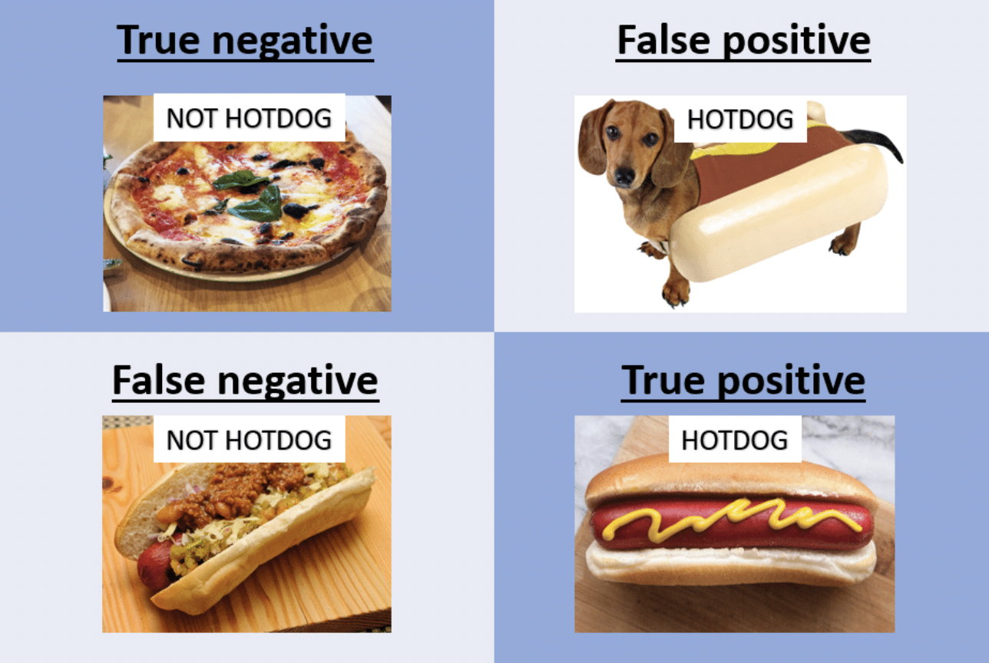
How to think about accuracy?
Accuracy (TN+TP)/ALL
Precision TP/Positive Select
Recall TP/Actually Positives
Number selected (Positive selects)

Slide 55
Discussion
People became more skeptical of everything (H1 results)
(good or bad depending on what is the objective) (if there are options for follow up or additional research, it’s good that skeptical to everything)
Suggestive evidence that people paid attention / remembered the tactics
Focusing on the tactic accuracy, precision, recall we also see that they are thinking more about the tactics - for each tactic they select them more, so accuracy slightly down or same while recall up
We don’t know what exactly is driving this
Generally skeptical about misinfo and thinking about the tactic
Priming - we mentioned the tactics and on the short run they just have them in their mind
Experimenter demand effect: they are guessing we want the tactic course to be effective so they are just selecting them all the time
Some of the tests: high variance and/or potentially small effects
Sharing outcome: small effect on better at identifying → expect some people to share less so for this even smaller, indirect effect only

Slide 56
Appendix
(Milestone 1)

Slide 57

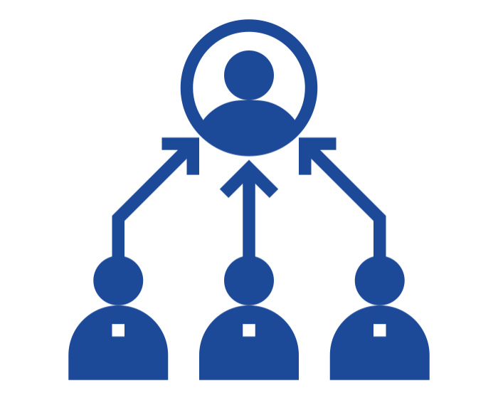
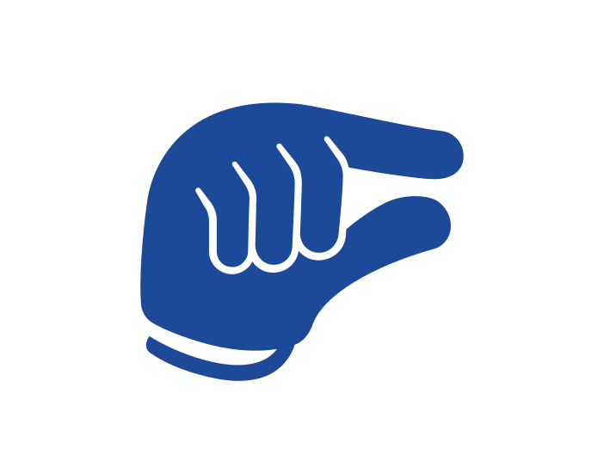
Considerations
What is the best use of the limited sample and time?
Limited time and sample size
Deliver the most effective course possible, focused on specific, less studied tactics:
Misleading graphs
Anecdotes
False comparisons
Representative sample (no targeting)
Draws on input from literature & partner
Recognizes misinformation and behavior is context specific
May help with low power
Partner expects us to see small effects
Notes:
General considerations and big picture of what we are doing, how we get to the research questions

Slide 58
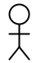
Pre-Post Testing with Control
Pilot Design
Control
Inter-person variance = lower power
3 separate comparisons
Treatment 1
Treatment 2
Treatment 3
Fewer samples per arm = lower power
1 test = less time taken

Slide 59
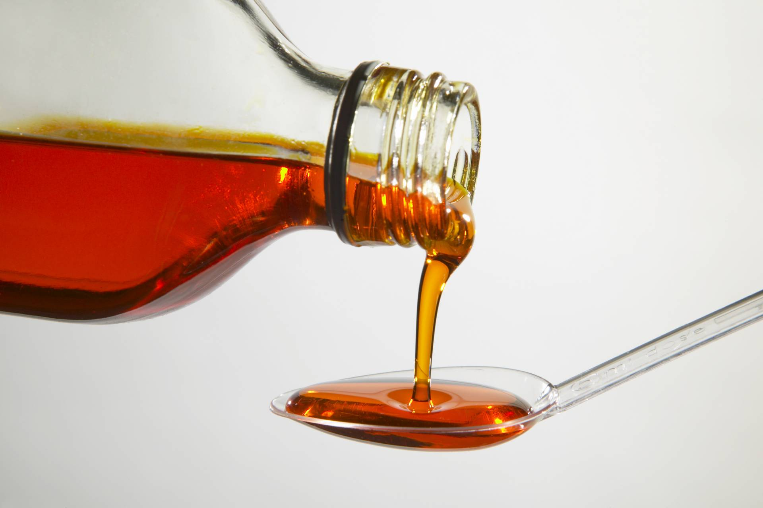
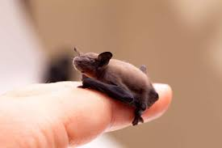
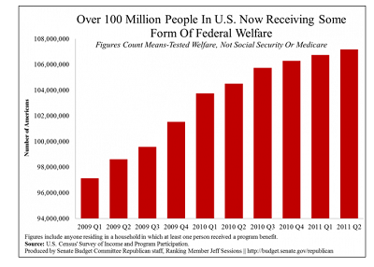
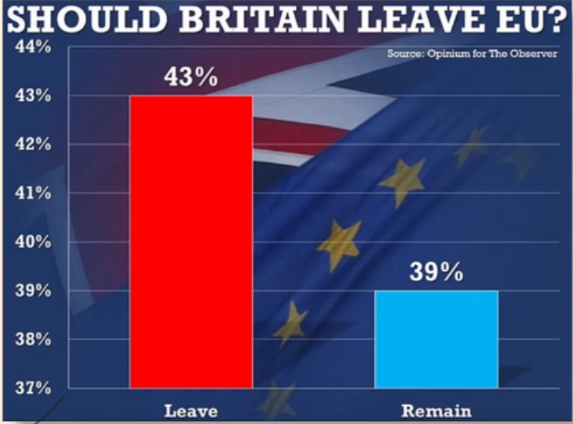

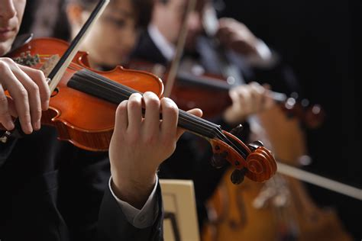
Pre-Post Testing with Control
New Design
More samples = more power
Pre Test
Control
Post Test
2 Truths
2 Truths
Lower variance
More treatment units
3-4 Tactics
3-4 Tactics
Treatment 1
Questions are stratified, then randomized
Matched results = higher power
2 tests = longer time + need for comparability

Slide 60
Pre-Post Testing with Control
Considerations
Design
Reduced variability since we match participants to themselves. This means higher power overall.
Longer survey time (less time for other elements)
Need to ensure comparability
Each topic has a pair of examples. We randomize which pair element is used pre and post test per participant.
Control group has a neutral treatment teaching them about sleep (using comparable format)

Slide 61
Treatment Overview
Mini-course focused on 3 tactics
Misleading graphs (original course)
Anecdotes (new!)
False Comparisons (new!)
Enhanced delivery with more interactivity
6 minute control course that is independent from outcomes

Slide 62
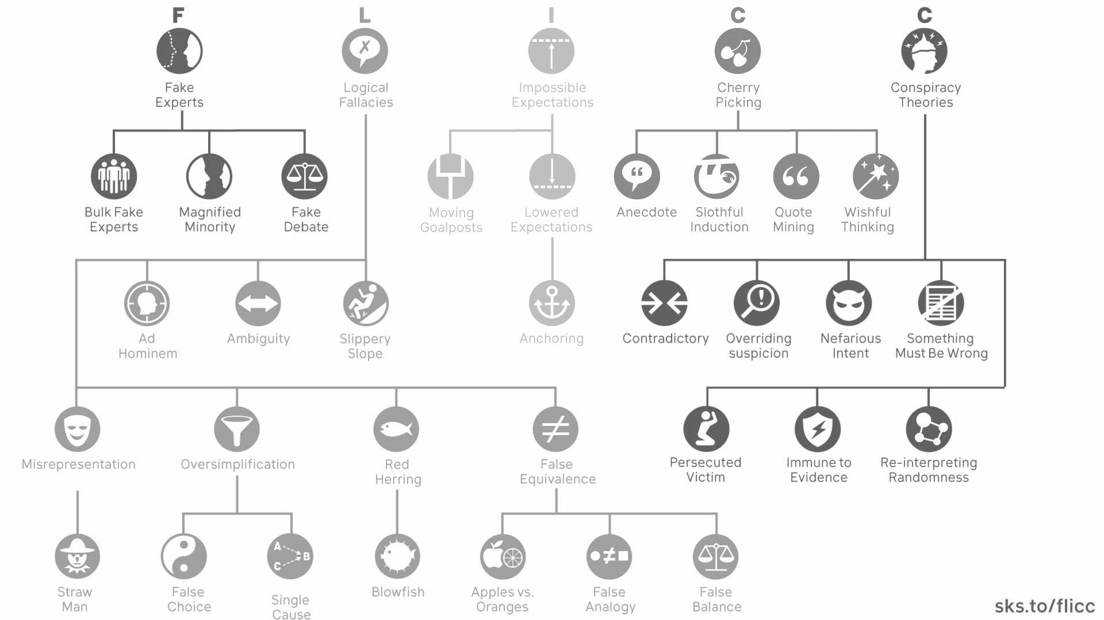
Treatment - New Tactics

Slide 63
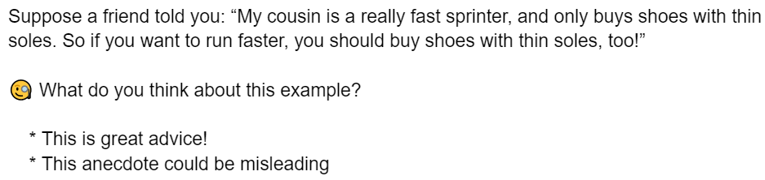
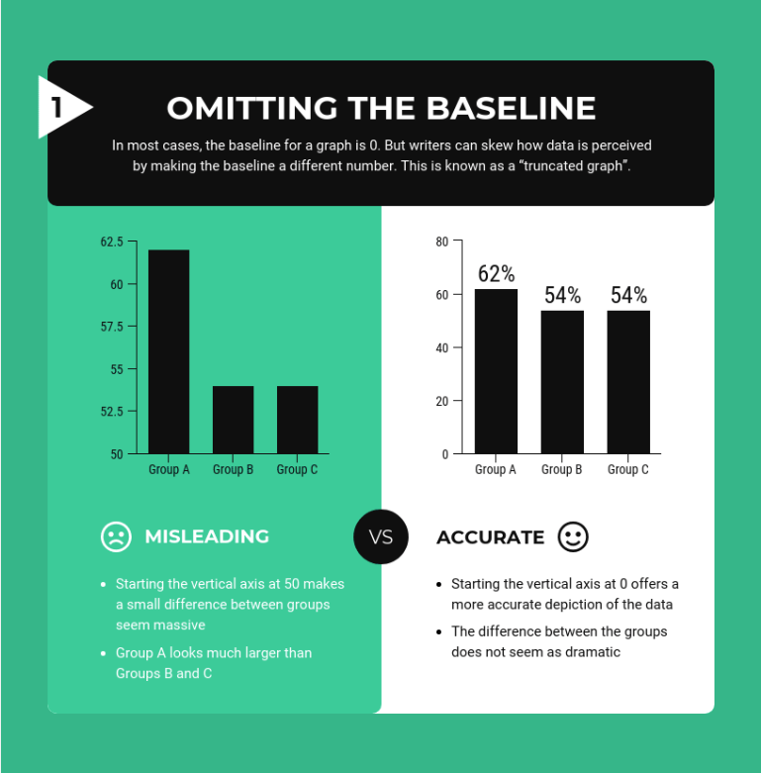
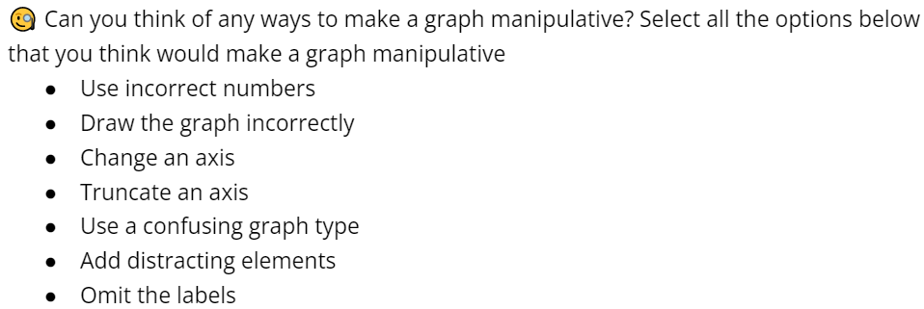
Treatment - Delivery
SMS Style Snippets
Examples
Infographics
Interactive Questions

Slide 64
Treatment - Control Task
6 minute control course that is independent from outcomes
Educative topic
Neutral topic
Not extremely boring, but also not too interesting
Why We Sleep

Slide 65
Treatments
Focused mini-course on tactics
Misleading graphs
Anecdotes
False Comparisons
Educative delivery similar to First Draft’s SMS course
Additional examples and interactive components to better deliver the concepts & effectiveness based on literature
Why we dropped delivery method (Delivery methods - use the best one, based on literature and partner (considered multiple treatments) → get best chance to have an impact & tactic effects & focus on HTEs)
Finding the right control (e.g. sleep, freezer burn, macula degeneration), deciding on tactics
Additional considerations: Neutral tone (not polarizing topics) Partner interest in less studied tactics

Slide 66
Outcome Questions
How manipulative do you find this post? (6 point scale)
Which aspect of the post is manipulative?
Would you like to share this post on social media? (6 point scale)
Would you want to talk to others about this information offline? (6 point scale)
Not dependent on context/past knowledge
Question combines binary and confidence questions, while still forcing participants to pick a side
Uses same scale as “Go Viral Game,” and same style as Roozenbeek & van der Linden (2019)
Other considerations in appendix
Notes:
What is desired behavior for true and false?
How do we ask the question to get truthful/accurate responses that are reflective of what users would actually do?
How do we prevent the questions from biasing future answers?
What questions/behaviors are topic agnostic?

Slide 67
Covariates
Demographic questions will help identify HTE. Covariates selected based on 3 factors:
HTE performance on pilot data | Trust in Dr. Fauci Income Race Think & reflect Searching for political news Blocking behavior on social media
Promising covariates in the literature | Susceptibility to misinfo based on pre-test (Roozenbeek and van der Linden 2019; Cook et al, 2017) Political interest and ideology (Guess et al, 2020; Chen et al, 2021)
First Draft priorities | Partisanship Education (income is proxy/related)
Notes:
Susceptibility: from literature and related to partner, Income from HTE and related to partner, Ideology from literature and partner

Slide 68
HTE performance on pilot
Covariate | Treatment | p-value corrected | estimate | std error
Block User Social Media | Tactic Quiz | 0.0006 | -3.74559 | 0.97026
Income | Tactic | 0.082 | -1.063796 | 0.525675
Think & Reflect | Tactics | 0.082 | -0.82738 | 0.47397
Block User Social Media | Tactics | 0.057 | -2.38104 | 1.01160
Fauci Trust | Tactics Quiz | 0.082 | -0.70682 | 0.39451
Search Political News | Tactics Quiz | 0.082 | -0.60098 | 0.34450

Slide 69
Hypotheses* (1/2)
H1: Participants will improve in rating misinformation as manipulative after taking the course ( |Δ_{post - pre} score identify|_{treatment} > |Δ_{post - pre} score identify|_{control})
score identify = outcome 1 if choice matches ground truth
= 7 - outcome 1 if choice opposite to ground truth
H2: Participants will be able to identify the 3 specified misinformation tactics better after taking the course ( |Δ_{post - pre} precision T|_{treatment} > |Δ_{post - pre} precision T|_{control})
precision T =
# tactics correctly identified
# of posts shown
* We expect small effect sizes ~ 10%
Notes:
H1: Participants will rate misinformation as significantly more manipulative after taking the mini-course.
H0,real: Participants will not rate real news as significantly more manipulative after taking the mini-course.
H2: Participants will be less likely to share misinformation after taking the mini-course.
H3: Participants will be more likely to research/fact check misinformation after taking the mini-course.

Slide 70
Hypotheses* (2/2)
H3: Participants will be less likely to share misinformation online after taking the course ( |Δ_{post - pre} share misinfo likelihood|_{treatment} < |Δ_{post - pre} share misinfo likelihood|_{control})
H4: Participants will be less likely to share misinformation offline after taking the course ( |Δ_{post - pre} share misinfo likelihood|_{treatment} < |Δ_{post - pre} share misinfo likelihood|_{control})
Share misinfo likelihood = Outcome 3/4 for misinformation questions
* We expect small effect sizes ~ 10%
Notes:
H1: Participants will rate misinformation as significantly more manipulative after taking the mini-course.
H0,real: Participants will not rate real news as significantly more manipulative after taking the mini-course.
H2: Participants will be less likely to share misinformation after taking the mini-course.
H3: Participants will be more likely to research/fact check misinformation after taking the mini-course.

Slide 71
Power overview
Simulation-based study
Corrections
Focused on:
Feasibility of experiment
Treatment and control design
Number of HTE to test
Multiple hypothesis corrections for correlated outcomes:
Romano-Wolf
Bootstrap
Benjamini-Hochberg
Detailed analysis follows

Slide 72
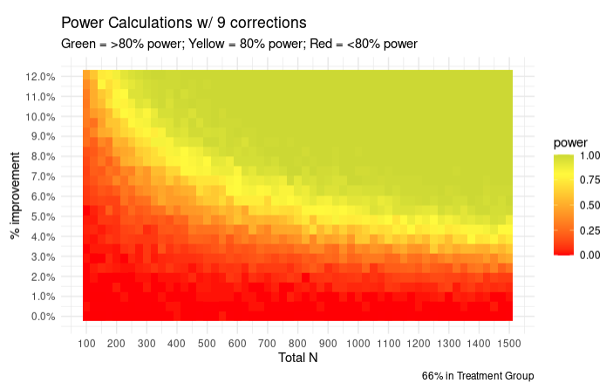
Power – Is our experiment feasible?

Slide 73
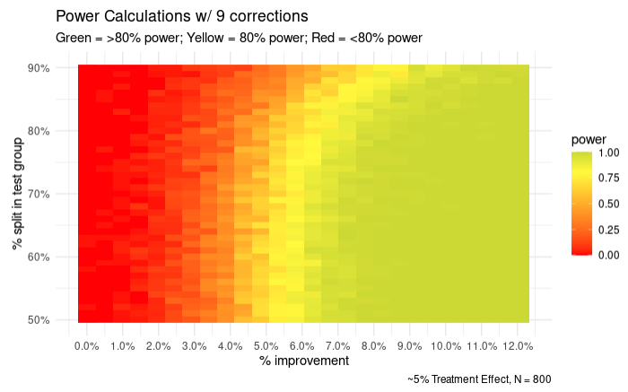
Power – How to split treatment and control?

Slide 74
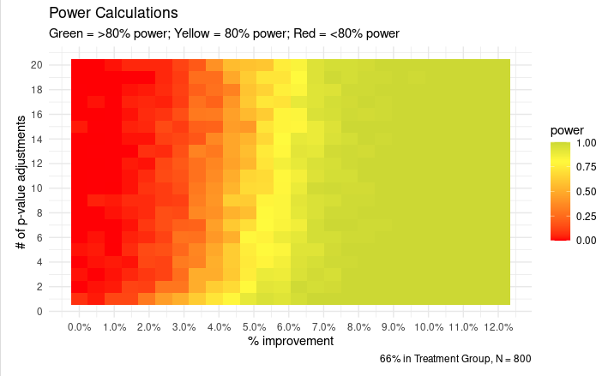
Power – How many HTE can we handle?

Slide 75
Analysis Plan
Data processing, covariate balance, and outcome metric calculation
Regression analysis of treatment effects on the outcomes
HTE analysis:
Analyze the pre-specified limited number (~3) covariates to detect HTE while maintaining power:
Susceptibility
Political ideology
Income
Also use a causal tree learning to leverage ML for HTE detection (may not report)
Multiple hypothesis testing correction
Power analysis through simulation (post experiment sanity check)

Slide 76
Outcome Questions - Additional Considerations
Fact Checking - Would you like to read more to find out the trustworthiness of this post?
Who would say no if there was no cost?
Discrepancy between answer and real life action
How to differentiate between researching more about interesting topic vs fact checking?
Reporting - Would you like to report this post to have it removed?
Our examples are neutral and not report worthy
Don’t want to encourage to report everything
Following - Would you stop following an account that posted content like this?
Topic/preferences specific
etc…

Slide 77
Cited work
Roozenbeek, J., van der Linden, S. Fake news game confers psychological resistance against online misinformation. Palgrave Commun 5, 65 (2019). https://doi.org/10.1057/s41599-019-0279-9
Guess, A. M., Lerner, M., Lyons, B., Montgomery, J. M., Nyhan, B., Reifler, J., & Sircar, N. (2020). A digital media literacy intervention increases discernment between mainstream and false news in the United States and India. Proceedings of the National Academy of Sciences, 117(27), 15536–15545. https://doi.org/10.1073/pnas.1920498117
Cook, J., Lewandowsky, S., & Ecker, U. (2017). Neutralizing misinformation through inoculation: Exposing misleading argumentation techniques reduces their influence. PLoS ONE, 12(5): e0175799. https://doi.org/10.1371/journal.pone.0175799
Chen, C. X., Pennycook, G., & Rand, D. G. What Makes News Sharable on Social Media? preprint, PsyArXiv, 9 July 2021. DOI.org (Crossref), https://doi.org/10.31234/osf.io/gzqcd.

Slide 78
Facts: 3 each

Slide 79
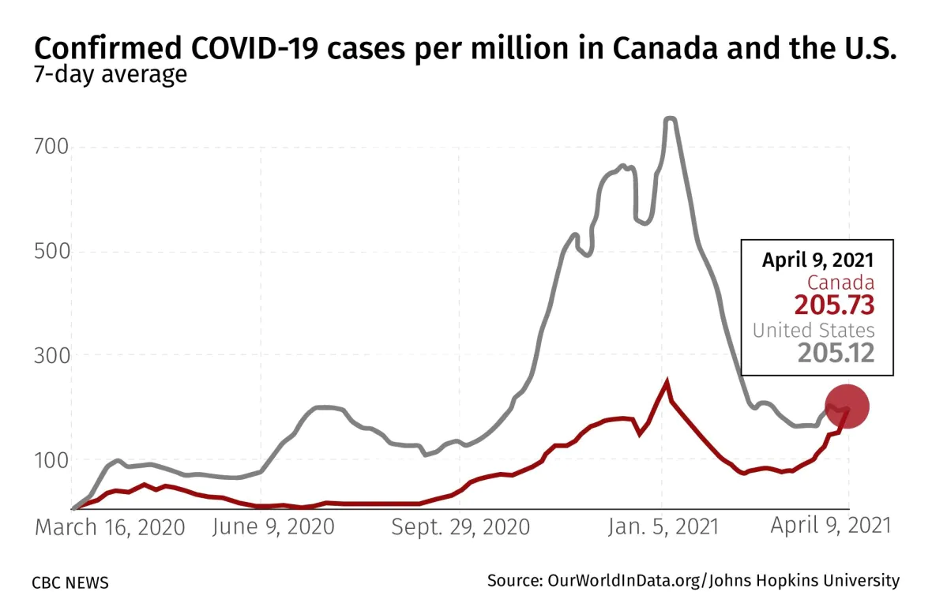
True Charts, Neutral Tone
Tom
4 hrs
Tom
4 hrs
Global overdose deaths from opioids more than doubled from 1990 until 2017. This is an important issue that needs more attention.
This graph shows how covid cases in Canada caught up to the US counts per million in April 2021. I worry about my parents who have been living in Canada since the lockdowns.

Slide 80


Truths
Sunne
4 hrs
Sunne
4 hrs
...
...
With a head-to-body length of 1.14 to 1.29 inches, the bumblebee bat is the smallest mammal in the world. To see this tiny bat for yourself, you’d have to visit one of a select few limestone caves on the Khwae Noi River in Kanchanaburi Province of southwest Thailand.
In 1986, eleven Russian men spent 370 days lying down in bed. The experiment was to help with future space expeditions, because a year in bed simulated weightlessness.

Slide 81


Truths
Tom
4 hrs
Tom
4 hrs
...
...
I read an article about how McDonald’s once made bubblegum-flavored broccoli. Unsurprisingly, the attempt to get kids to eat healthier didn’t go over well with the child testers, who were “confused by the taste.”
My sister is working on better solutions to solving obesity in communities without access to healthy food. It’s been shown that being overweight may shorten your life, in some cases by a decade or more.

Slide 82
Misinfo Tactics

Slide 83
Misleading Graphs
Tom
4 hrs
Tom
4 hrs
1,576,674
NO
8,430,222
YES
Support for unions has significantly decreased over the years. However, this new poll shows just how many workers actually support unionizing.
Recent polling has shown how most people think that britain should leave the EU.
Topics: Vaccine, Children

Slide 84

False Comparison
Tom
4 hrs
Tom
4 hrs
...
...
Trying to quit smoking? You should try the Lharbanti Meditation technique that has been scientifically proven to help thousands of people overcome their addiction to video games.
Studies have shown that students who attend schools with expansive music programs tend to perform much higher on standardized testing. If your child is struggling with grades, enroll them in the Von Gesualdo music program!

Slide 85
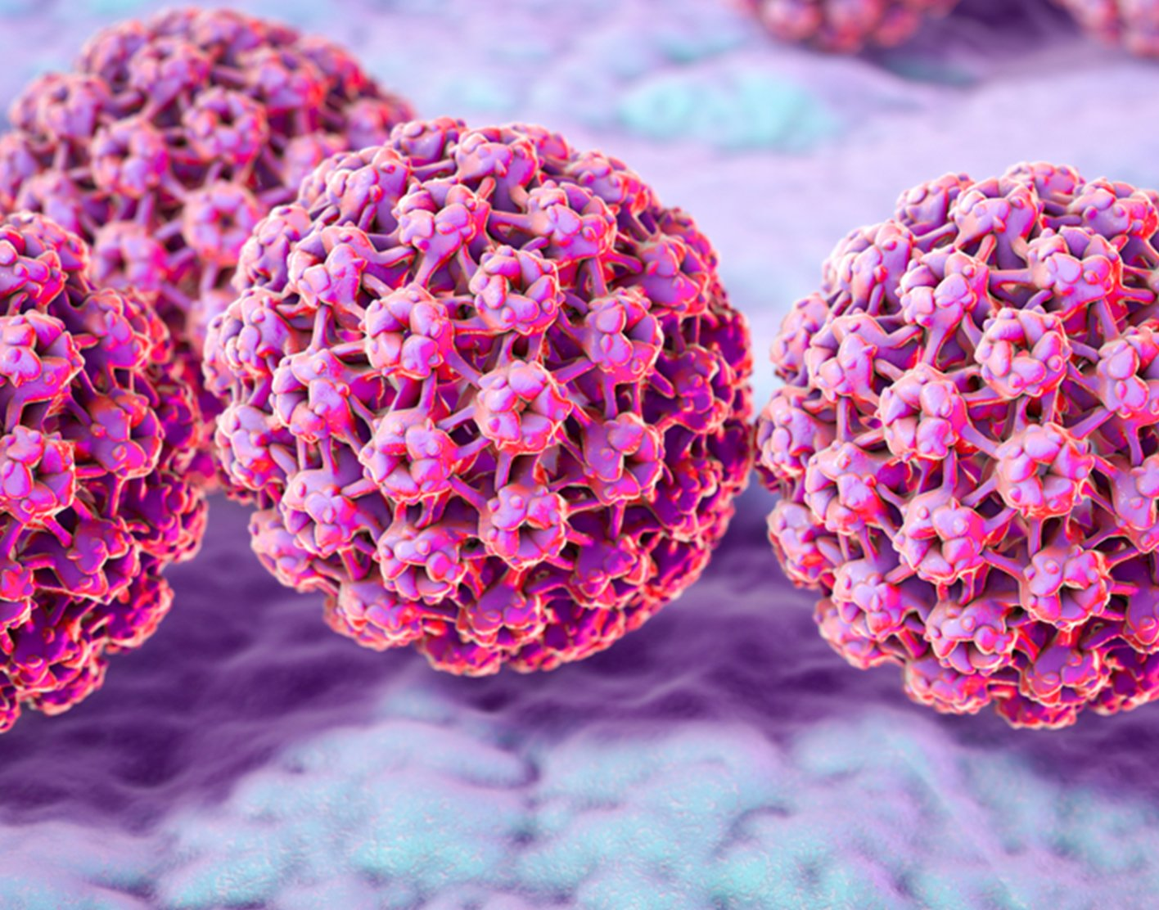

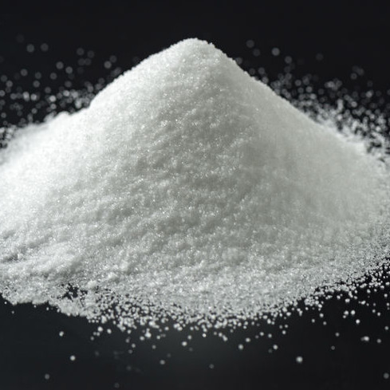
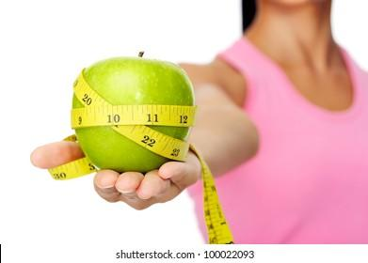
Anecdotes
Tom
4 hrs
Tom
4 hrs
...
...
My grandmother smoked a pack of cigarettes a day and ate whatever she wanted. She outlived my grandfather who restricted himself to a vegetarian diet. This shows that the secret to longevity is to live freely, doing what you enjoy.
Last month, my friend recommended a diet plan focused around apples to prevent migraines. I have not had a headache since starting this diet. Who knew that apples were the secret to preventing headaches!

Slide 86
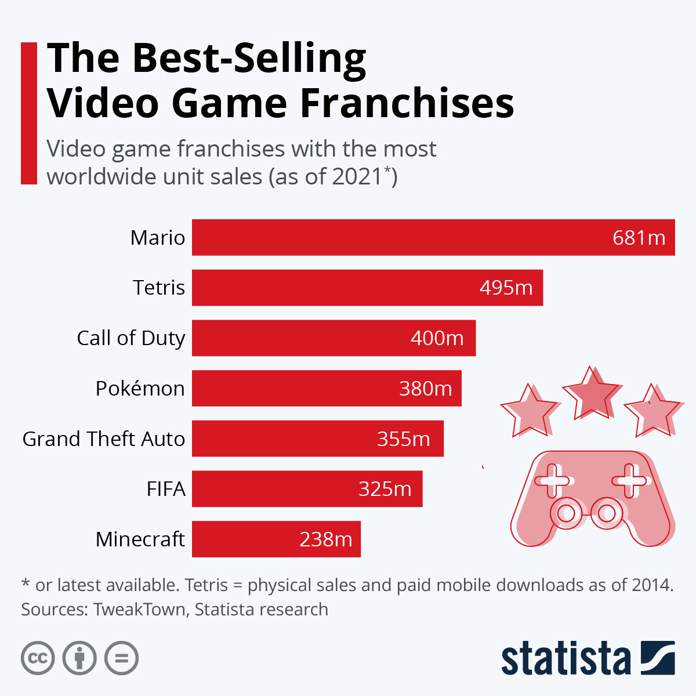
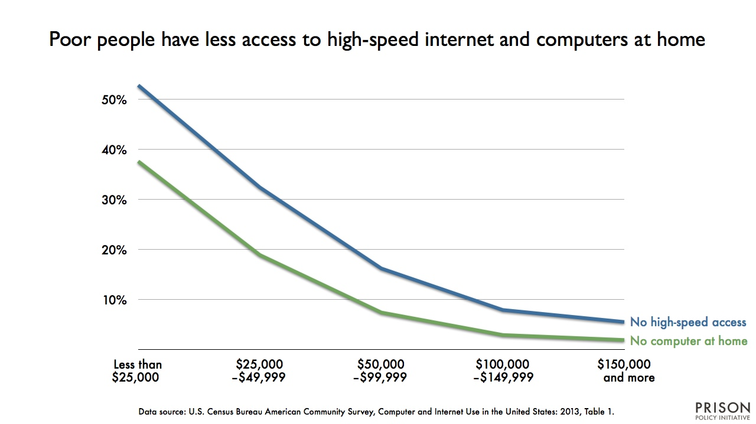
Combined
Tom
4 hrs
Tom
4 hrs
...
I grew up with slow internet speeds and now work at a minimum wage job. Parents should set their children up for success by subscribing to high speed internet and getting the fastest computer they can afford.
My younger brother loves mario and tetris, which are the best selling video games in 2021. Movie studios should release a mario tetris collaboration movie, which would be a huge success with young boys.

